Slide 1
Training on the use of the enterprise research data security plan (ERDSP) for VA Research Investigators and Staff
Dial in (Main): (404) 397-1596
Attendee Access Code: 199-364-7763
Slides available on SharePoint:
See link in Q&A Box
Terry Peters and Carol Johnson
IT Cybersecurity Specialists
OIS-SSS-Research Support Division (RSD)
March 23, 2021

Slide 2
Rules of the Road
Microsoft Teams
is used during today’s training
session
This is a lectured call – attendees’ lines will be muted during the presentation
Attendees’ questions will be addressed during an open question and answer (Q&A) forum following the presentation
When the lines open for Q&A:
Please be respectful of others and mute your phones unless you are asking a question
Do not place the call on “Hold”, as this may place music into the conference call
Use the Microsoft Teams chat box to submit your question or wait until the Q&A forum following the presentation
Subject Matter Experts (SMEs) will address questions in the order that they are received

Slide 3
Training Agenda
01
Importance of the Use of the ERDSP Toolset
06
Review and Use of the ERDSP Toolset
02
Discuss the ERDSP Toolset Roles and Responsibilities
07
Review of Training Scenarios
03
Overview of the ERDSP within the IRB/R&D Protocol Review Process
08
Demo & Walk Through of ERDSP Toolset & Accessing the ERDSP Toolset in VAIRRS/SharePoint
04
Review of Phased Implementation Schedule
09
Submitting ERDSP Toolset Feedback
05
Determining When a Protocol Requires ISSO Review
3

Slide 4
Why is the ERDSP Necessary?
Developed in accordance with the recent amended technical policy to VHA Directive 1200.01
An enterprise standardized template and plan designed to provide research Principal Investigators (PIs) with a tool to aide in documenting the safeguards to protect research data, information, and resources. Provides a mechanism for PI’s to document their plan for managing risks to protect research data within a research protocol and promotes the standardization of the ISSO review during the IRB/R&DC review process.
Assists PI’s with documenting how research data (human subject, basic science, animal) will be used and protected through a research protocol’s life-cycle
Central element of the selection of administrative, technical, and operational safeguards and implementation of research protocol data risk management assisting Information System Security Officer (ISSOs) with employing consistent security review checks
Developed in response to a comprehensive risk assessment conducted on research protocol data management practices with VHA Data Owners ORD and ORO Stakeholders and 2018 ORD/ORO Research Information Security Vulnerabilities Memorandum
4

Slide 5
Why is the ERDSP Necessary? (cont.)
Introduces a standardized process for conducting the ISSO research protocol review to support effective Research Protocol Data Management
Improve the data security planning process for research protocols by Principal Investigators (PIs) and research data stewards
Enable ISSOs to more consistently review and assess risks associated with research protocol/study and identify commensurate security controls resources based on high-risk areas and specific conditions.
Recommend baseline information security controls to guide the ISSO protocol security review process to ensure confidentiality, integrity, and availability of research data and systems
Toolset includes a tailored baseline of information security controls that maps critical administrative, physical, and technical security controls to the NIST Cybersecurity Framework (CSF)
5

Slide 6
Key Stakeholder Roles and Responsibilities
ERDSP Key
Stakeholders
Principal Investigators
Local Facility ISSO
R&D Committee
Research Support Division
Principal Investigators (PI)
Completes and submits an ERDSP for each proposed and/or amended research protocol
Coordinating and collaborating with the ISSO to resolve research study related information security compliances issues
Local Facility ISSO
Provides guidance to Principal Investigators and R&D Committee stakeholders in resolving research information security compliance issues
Reviews high risk research protocols that are identified within the ERDSP toolset
Signs and approves the submitted ERDSP for proposed and/or amended research protocols
Principal Investigators
Local Facility ISSO
Research & Development (R&D) Committee
Reviews research proposals and approves the research, requiring modification to obtain approval or disapproving the research
Ensures ISSO review of studies that involve the collection, processing, storage, and transmission of research data are complete before a study is given final approval.
Research Support Division
Provides the ERDSP toolset, user guidance, and training & awareness to R&D Committee Stakeholders
Maintain ERDSP toolset, user Guide documentation
R&D Committee
Research Support Division
6

Slide 7
Overview of the use of the ERDSP in the IRB/R&D Committee Review Process
The ERDP submission process will consist of:
PIs complete and submit an ERDSP for each new and amended research protocol
PIs determine if any research study conditions (high-risk) apply
If any research study conditions apply to a new research protocol, the ERDSP and research study submission is submitted to local facility ISSO for review
If a research study amendment makes changes to any of the high-risk sections of the ERDSP, the ERDSP and research study submission is submitted to local facility ISSO for review
If no research study conditions apply/or there is no change to the high-risk sections of the ERDSP, the PI submits ERDSP and research study submission to R&D Committee or subcommittee for acknowledgement

Slide 8
Overview of the use of the ERDSP in the IRB/R&D Committee Review Process
The ERDP submission process will consist of:
The local facility ISSO reviews the ERDSP and research protocol to determine if the ERDSP is adequate and compliant
PIs make any required changes or corrections to the ERDSP, and resubmits the ERDSP to the facility ISSO
Local facility ISSO approves the ERDSP signifying the proposed protocol and/or amendment’s compliance with VA security policy
OIS-Research Support Division provides guidance to Local ISSO (as needed)
PIs submits the approved ERDSP with the protocol to the R&D Committee or subcommittee

Slide 9
ERDSP Phased Implementation Plan
Phase 1: Pilot & Soft Launch 30 VA research facilities will begin using the new ERDSP toolset to support the IRB/R&D committee protocol review processes and procedures 3/22/21 – 4/19/21
Phase 2: Collect and incorporate feedback 4/19/21 – 4/26/21
Phase 3: Training to the field 4/26/21 – 5/7/21
Phase 4: Full Operational Capability 5/10/21
VA Research Principal Investigators are required to submit an ERDSP for each human, animal, and basic laboratory protocol/amendment submission detailing the proposed study's/protocol’s plan for implementing reasonable safeguards to protect research data.
VA research facilities not participating in the Phase 1 pilot/soft launch, will continue to use their local procedures and/or research information security templates/checklists and data security plans in the interim, until the transition to the ERDSP toolset is complete

Slide 10
ERDSP Phased Implementation Plan
VA Research Facilities Participating in the ERDSP Pilot and Soft Launch
Boston VAHCS | Columbia, MO VAMC | VA North Texas HCS
VA Palo Alto HCS | Memphis, TN VAMC | Cleveland, OH VAMC
San Diego, CA VAMC | Durham VAHCS | Baltimore, MD VAMC
San Francisco, CA VAMC | Albuquerque, NM (CSP Coordinating Center | Loma Linda, CA VAMC
Portland, OR VAMC | Indianapolis, IN VAMC | Louisville, KY VAMC
Bedford, MA VAMC | Atlanta, GA VAMC | Denver, CO VAMC
Tennessee Valley HCS | Providence, RI VAMC | Charleston, SC VAMC
VA Puget Sound HCS | VA Connecticut HCS | Iowa City, IA VAMC
Houston, TX VAMC | VA Ann Arbor MI VAMC | Minneapolis, MN VAMC
VA Greater Los Angeles HCS | Edward Hines Jr. VA Hospital | San Antonio, TX VAMC

Slide 11
When is an ERDSP Required
Add in
New Research Protocol - An ERDSP is required for all new research protocols (human, animal, basic laboratory).
Research Protocol Amendment: An ERDSP is required to be completed for all research protocol amendments.
ERDSP Toolset provides clear indication to PI/ISSOs when an ISSO review is required.
ERDSP User Guide provides additional contextual and situational guidance to assist PIs with completing the ERDSP toolset and provides guidance to ISSOs on conducting reviews to identify reasonable/commensurate security controls

Slide 12
Determining if a New Research Protocol Requires an ISSO Review
If the proposed research protocol meets any of the following high-risk conditions, an ISSO review of the research protocol is required:
Will any VA Sensitive Information (VASI) be accessed, stored, generated or transmitted during the research study?
Will the research study use any VA mobile devices or mobile applications?
Will any research study/protocol data be transmitted or transferred to an external entity?
Will the research study use any external information systems or devices?
ERDSP Toolset provides clear indication to PI/ISSOs when an ISSO review is required.
ERDSP user guide provides additional contextual and situational guidance to assist PIs with completing the ERDSP toolset and provides guidance to ISSOs on conducting reviews to identify reasonable/commensurate security controls

Slide 13
ERDSP Audit Sample and Systematic Review Procedures
Proposed research studies and amendments, not requiring an ISSO review will be audited to ensure the ERDSP template was properly completed.
RSD is working with ESO to develop a process for auditing research studies and amendments not requiring an ISSO review. The audit process will be incorporated into the ESO Research Information Security Compliance SOP and the SOP will be updated to align with the technical amendment to VHA Directive, 1200.01.

Slide 14
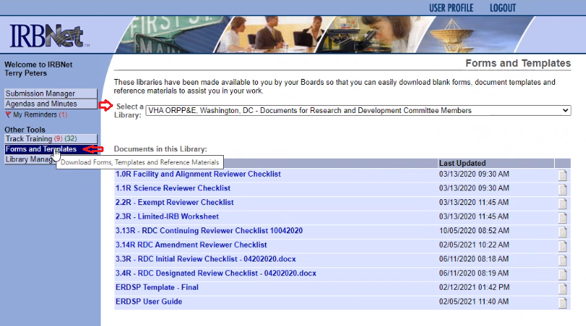
ERDSP Location/Quick Start Guide
How to Locate the ERDSP Toolset and supporting User Guide
For VA Research & Development (R&D) facilities that have transitioned to using the VA Innovation and Research Review System (VAIRRS), both the ERDSP template and user guide can be found in the following VAIRRS libraries under forms and templates.
Begin by locating the toolset and user guide within the following VAIRSS libraries:
VHA ORPP&E, Washington, DC – Documents for Animal Committee Members
VHA ORPP&E, Washington, DC – Documents for Human Subjects Committee Members
VHA ORPP&E, Washington, DC – Documents for Safety and Biosafety Committee Members
VHA ORPP&E, Washington, DC – Documents for Research and Development Committee Members
VAIRRS Portal link
14

Slide 15
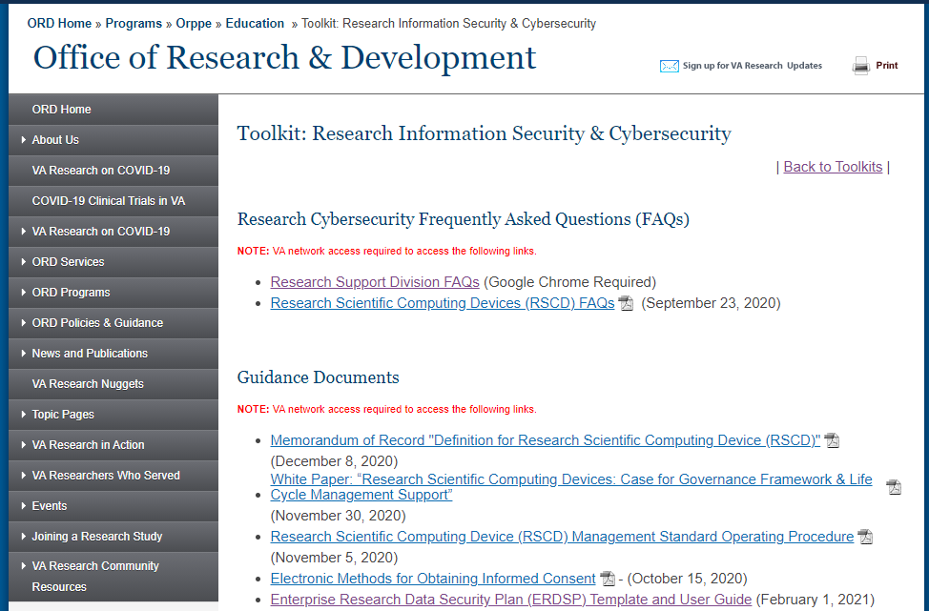
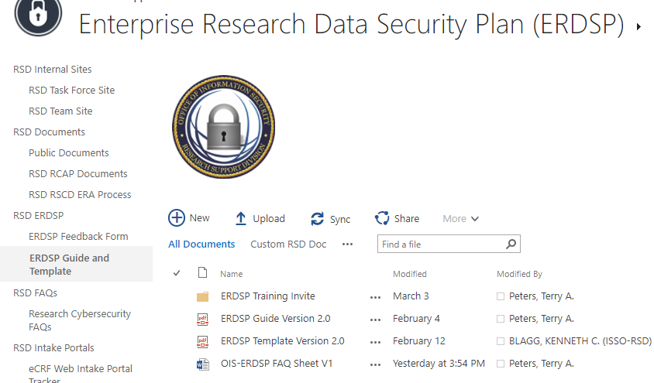
ERDSP Location/Quick Start Guide (cont.)
How to Locate the ERDSP Toolset and supporting User Guide
For VA R&D facilities that have not transitioned to using VAIRRS, both the ERDSP tool and user guide will be available within several online web portals
Begin by locating the toolset and user guide within the following web portals:
ORD Toolkit: Research Information Security & Cybersecurity
OIS Research Support Division Public Documents
PIs completing the ERDSP template are recommended to use the ERDSP guide to assist with responding to the questions on the ERDSP toolset.
ISSOs reviewing a submitted ERDSP from a PI are recommended to use the ERDSP user guide to assist with completing the security review.
Using the user guide to complete the ERDSP toolset will reduce the chance of the study/protocol submission being returned by the ISSO to the PI for additional information.
*Note: Latest version of the ERDSP toolset and accompanying user guide will be maintained in the above portals and repositories.
OIS-SSS-RSD Team will send out updates when changes or enhancements are made to either document.
15

Slide 16
Overview of the ERDSP Toolset Sections
In order to successfully complete the ERDSP for new protocols and research study amendments, we will be reviewing each section of the ERDSP toolset.
Section 1: Research Study Conditions
Section 2: Data Classification
Section 3: Data Sources & Collection
Section 4: Data Access & Storage
Section 5: Data Sharing with VA Research Facilities
Section 6: VA Mobile Devices/Media, Mobile Applications, Medical and RSCDs
Section 7: VA Software
Section 8: Agreements, Authorizations and Contracts
Section 9: Data Sharing with External Entities and External Information Systems
16

Slide 17
Section 1 – Research Study Conditions
Please answer the following questions, if any are answered "Yes" the study will require an ISSO review.
1. Will any VA sensitive Information (VASI) be accessed, stored, generated or transmitted during the research study? 2. Will the research study use any VA mobile devices and/or mobile applications? 3. Will any research study data be transmitted or transferred to an external entity? 4. Will the research study use any external information systems or devices?
17

Slide 18
Training Scenario #1
Research Study Condition #3: Will any research study data be transmitted or transferred to an external entity?
RESEARCH STUDY CONDITION #3 SCENARIO: The Tampa VAMC is participating in a collaborative research study with the University of South Florida. Each VA research subject has executed a HIPAA authorization for the disclosure of a copy of their data to the University of South Florida. The VA will disclose a copy of the de-identified research data to the collaborator using an encrypted CD/DVD. How should this question be answered?
Yes, VA research data is being transferred to the University of Florida using an encrypted CD/DVD.
18

Slide 19
Training Scenario #2
Research Study Condition #4: Will the research study use any external information systems or devices?
RESEARCH STUDY CONDITON #4 SCENARIO: The Atlanta VAMC will be conducting a VA only TBI study. The study plans to use a research scientific computing device owned by their affiliate university and the device is connected to the affiliate university LAN extension located within the Atlanta VAMC. How should this question be answered?
Yes, The affiliate university research scientific computing devices is considered an external information system.
19

Slide 20
Section 2 – Data Classification
1. Select the classification of the data that will be used in the research study.
Sensitive (RA-2).
Sensitive Data Types
Non-Sensitive Data Types
Public Data Types
Individually Identifiable Information (III), Personally Identifiable Information (PII), Personal Health Information (PHI), Animal Research (Category D & E picture & video), Genomic (Human), Intellectual Property, (FIMSA Requirement = Moderate FISMA Baseline Impact).
De-Identified Research, Unpublished Research (Basic Animal except for category D & E picture and video, Non-Human Basic Lab), Animal Research (Category B & C), (FISMA Requirement = Moderate FISMA Baseline Impact).
Published Research (Aggregate data, submitted for peer review journals and/or presented at conferences, included in grant applications), (FISMA Requirement = Low FISMA Baseline Impact
Policy References:
Definition of VASI (VHA Handbook 1605.01, VA Handbook 6500)
NIST SP 800-60, Volume II Revision 1: “Appendix D.14.5 - Health Care Research and Practitioner Information Type”
ERDSP User Guide: Appendix D - Minimum Security Control Standards
20

Slide 21
Training Scenario #1
SCENARIO: The North Florida/South Georgia VHS will be conducting a collaborative animal research study with their affiliate university. The research study data collected will contain picture and video of mice assigned to USDA Pain & Distress Category D&E. The VA will be electronically sharing a copy of the study data with the affiliate university, should the data be encrypted in transmission?
Yes, animal research that is USDA category D&E with picture and video is considered sensitive.
21

Slide 22
Section 3 – Data Sources and Collection
1. Does the research study involve more than one VA participating site?
2. Provide the name of each participating VA site listed within the IRB application.
3. Select the data sources to be used in this research study. Select all that apply.
Available Selections
CAPRI/Joint Legacy Viewer (JLV) | Pharmacy Benefits Management (PBM)
Corporate Data Warehouse (CDW) | Research Study Subject
CPRS/Vista/Cerner | VA/CMS Data for Research
Databases | Vista Web
Million Veteran Program | Other
Non-VA Medical Records
22

Slide 23
Section 3 – Data Sources and Collection (cont.)
Describe the Other and/or database sources used in the research study.
Select the data collection methods that will be used in the research study.
Available Selections
Audio Recording | Interviews
Behavioral Observations | Paper Questionnaire
Biological Specimens | Photographs
Chart Reviews | Video Recording
Control/Focus Groups | Wearable Technologies
Electronic Questionnaire | Other
6. Describe the Other data collection methods used in the research study.
7. Will the research study use any VA applications or websites?
8. Provide the name and URL (web address) of VA applications and/or websites that will be used in the research study.

Slide 24
Training Scenario #1
SCENARIO: The San Antonio and Houston VAMCs will be participating in a VA only multi-site study. The study plans to use the University of Minnesota REDCap application to collect study data from each participating VA site. Does the University of Minnesota REDCap application need to be evaluated for a VA ATO?
Yes, the University of Minnesota is not a collaborator on the study but is acting as a 3rd party and collecting data on behalf of the VA. The university of Minnesota REDCap application will need to be submitted for an ATO determination.
24

Slide 25
Section 4 – Data Access and Storage
1. Will access to the research study's electronic data employ the concept of least privilege, allowing only authorized access to users (or processes acting on behalf of users) which are necessary to accomplish assigned tasks in accordance with VA organizational mission and business functions?
2. Describe how sensitive hard copy (paper) documents will be physically secured?
3. Provide the storage location of the VA research study electronic and paper data stored at the VA or offsite research locations.
4. Will the research study use a standalone computer, medical, and/or research scientific computing device?
5. Describe the process to back up the VA research study data stored on the standalone computer systems, medical devices, and/or research scientific computing devices.
25

Slide 26
Training Scenario #1
SCENARIO: Dr. Williams is preparing the ERDSP for his new research study and the ERDSP requires Dr. Williams to provide the storage location (file path) for electronic data stored on the VA network. How can Dr. Williams determine the correct file path to the data?
Dr. Jones can reach out to their administrative officer for assistance or submit a YourIT ticket to the local ITOPS EUO operations requesting assistance in determining the file path to the data.
26

Slide 27
Section 5 – Data Sharing with VA Research Facilities
1. Will the research study share data with another VA facility?
2. Provide the name of each VA research facility that data will be shared with and describe the method used to securely transfer the data.
3. Will research study personnel physically transport sensitive data outside their VA facility?
4. Describe how the sensitive data being physical transported will
be secured during transit.

Slide 28
Training Scenario #1
SCENARIO: The Portland VAMC is participating in a COVID-19 research study that requires VA research study staff to collect nasal swabs from VA research subjects' homes. Study staff will be using a VA laptop during the visit to collect sensitive information from the research subject. Are study staff conducting the home visits required to have a documented authorization to transport sensitive information outside the VA controlled environment?
Yes, the VA is required to maintain accountability of sensitive information contained in digital and/or non-digital media during transport outside of controlled areas.
28

Slide 29
Section 6 - VA Mobile Devices/Media, Mobile Applications, Medical and Research Scientific Computing Devices
If a VA mobile devices/media, mobile application, medical or research scientific computing device will be used in the research study, select the appropriate box.
☐ VA Mobile Applications ☐ VA Mobile Devices/Media, Medical and
Research Scientific Computing Devices
VA Mobile Devices/Media, Medical and Research Scientific Computing Devices
1. Select the type of VA mobile devices/media, portable storage, medical or research scientific computing devices that will be used in the research study.
Selections
Audio Recorder | Wearable Device
Digital Camera | Smart Phone
CD/DVD | Tablet
Cell Phone | USB Flash Drive
External Hard Disk Drive | Video Recorder
Laptop | Other
29

Slide 30
Section 6 - VA Mobile Devices/Media, Mobile Applications, Medical and Research Scientific Computing Devices (cont.)
2. Provide the make, model, EE number for each VA mobile, medical and research scientific computing device.
3. Are all VA mobile devices/media and portable storage devices encrypted with FIPS 140-2 (or successor) validated encryption?
4. Will VA mobile and portable storage devices that contain the only copy of VA data, be backed up at regular intervals.
5. Describe the process for backing up VA mobile and portable storage devices that contain the only copy of VA data.
6. Describe the process for securing VA mobile and portable storage devices when not in use.
30

Slide 31
Section 6 - VA Mobile Devices/Media, Mobile Applications, Medical and Research Scientific Computing Devices (cont.)
VA Mobile Applications
1. Will the research study use any VA mobile applications?
2. Provide the name of the VA mobile application, application owner, application download link and the purpose of the mobile application in the research study.
3. Has the mobile application been approved for use in the VA?
31

Slide 32
Training Scenario #1
SCENARIO: The Boston VAMC is participating in a collaborative research study with their affiliate university. Each VA research subject has executed a HIPAA authorization for the disclosure of a copy of their study data to the affiliate. The VA PI plans to purchase an external hard disk drive with grant funds to transfer the data to the affiliate university. What steps should the VA investigator take before purchasing the external hard disk drive?
The PI should consult with the with the Area Manager and obtain area manager approval to purchase the external hard disk drive.
Verify the hard disk drive being purchased is on the security engineering list of FIPS 140-2 Validated Removable Storage Devices.
After purchasing the external hard disk drive, the device must be added to the appropriate VA equipment inventory list (EIL).
The device must be securely stored when not in use.
32

Slide 33
Section 7 – VA Software
1. Will any software be purchased or acquired for use in the research study?
2. Is the software approved for use in the VA Technical Reference Model (TRM)?
3. Provide the name of the software, vendor, vendor website address, and the purpose of the software.
33

Slide 34
Training Scenario #1
SCENARIO: A VA PI plans to use grant funds to purchase research analytical software for use in a research study and the software will be installed on a network connected VA computer. What are the steps the investigator should take before purchasing the software?
The PI should coordinate the purchase with the Area Manager and obtain their approval for the purchase.
The PI should verify the software is listed in the TRM Technology/Standard List.
The PI should also review the decision tab of the software’s TRM entry in the TRM technology/Standard List to ensure the version of the software being purchased is approved for use, and the planned usage of the software meets the decision constraints.
If the software being purchased for the research study is not on the TRM technology/standard list, it must be assessed by TRM before the software is purchased. Requests for TRM assessment of new software are submitted via the TRM Content Request Form.
34

Slide 35
Section 8 – Agreements, Authorizations and Contracts
1. Will the research study have any agreements, authorizations or contracts?
2. Select the types of agreements and authorizations that will be used in the research study and if the research study will involve the use of a contract.
Available Selections
Contract | HIPAA Authorization
Cooperative Research & Development Agreement (CRADA) | Material Transfer Agreement (MTA)
Data Use Agreement (DUA) | Other
3. Describe the purpose of each agreement or contract and provide the names of each entity involved in the agreement or contract.
35

Slide 36
Training Scenario #1
SCENARIO: The San Francisco VAMC is conducting a VA only research study and the PI plans to contract with an external entity to conduct electronic surveys of VA research subjects enrolled in the study. Should the external entities information system be submitted for a VA ATO determination?
Yes, the contractor’s information system is collecting data on behalf of the VA and should be submitted for an ATO determination.
36

Slide 37
Section 9 – Data Sharing with External Entities and External Information Systems
1. Will any research study data be transmitted or transferred to an external entity?
2. Provide the name of the external entity(s) and describe the method used to securely transfer the research study data.
3. Will VA retain ownership of the research study data shared with the external entity?
4. Will the research study use any external information systems, applications or devices?
5. Who owns the data being collected, processed or stored on the external information system?
6. Select the type of External Information system or application that will be used in the research study.
Selections
eConsent Application | Electronic Patient-Report Outcomes (ePRO) Application
Electronic Case Report Form (eCRF) Application | Interactive Web Response System (IWRS)
Electronic Data Capture (EDC) System | Interactive Voice Response System (IVRS)
Electronic Clinical Data Mgt. System (eCDMS) | Non-VA REDCap Application
Electronic Clinical Trial Mgt. System (eCTMS) | Survey/Questionnaire Application
Electronic IRB System (eIRBS) Application | Other
37

Slide 38
Section 9 – Data Sharing with External Entities and External Information Systems (cont.)
7. Provide the name, web address and purpose of each information system or application used in the research study.
8. Will an external entity provided mobile, portable storage, medical or research scientific computing device(s) to be used in the research study?
9. Select the type of external entity provided mobile, portable storage, medical or research scientific computing device(s) that will be used in the research study.
Selections
Audio Recorder | Scientific Computing Device
Digital Camera | Smart Phone
CD/DVD | Tablet
Cell Phone | USB Flash Drive
External Hard Disk Drive | Video Recorder
Laptop | Wearable Device
Medical Device | Other
38

Slide 39
Section 9 – Data Sharing with External Entities and External Information Systems (cont.)
10. Provide the make, model, owner and purpose of each external entity provided mobile, portable storage, medical and research scientific computing devices used in the research study.
11. If any affiliate mobile, portable storage, medical, research scientific computing devices or laptops will be used in the research study, will the devices be used at a VA facility?
12. Will the research study use any external entity provided mobile applications?
13. Provide the name of the mobile application, entity providing or creating the mobile application, website to download the application and the purpose of the application in the research study.
39

Slide 40
Training Scenario #1
SCENARIO: The San Antonio VAMC is conducting a collaborative research study with their affiliate university. Each research subject has consented to providing a copy of their study data to the affiliated university but the affiliate university eCRF application is blocked by the VA CSOC. As a work around the PI plans to use a DSL internet connection located in the San Antonio VAMC research service that does not have a VA ATO. Can this system be used to transmit the data?
No, the information system does not have a VA ATO and is considered an external information system.
40

Slide 41
When is an ERDSP Required for a Research Study Amendment?
Add in
An ERDSP is required to be completed for all research protocol amendments.
ERDSP Toolset provides clear indication to PI/ISSOs when an ISSO review is required.
ERDSP User Guide provides additional contextual and situational guidance to assist PIs with completing the ERDSP toolset and provides guidance to ISSOs on conducting reviews to identify reasonable/commensurate security controls

Slide 42
Determining if a Research Protocol Amendment Requires an ISSO Review
If the Research protocol amendment changes any of the ERDSP template sections/questions related to the research study conditions, an ISSO review is required. The ERDSP will display an “ISSO Review Required” banner above the PI signature block if an ISSO review is required.
If the research study amendment is only making minor changes to the research study, an ISSO review is not required.
ERDSP Toolset provides clear indication to PI/ISSOs when an ISSO review is required.
ERDSP User Guide provides additional contextual and situational guidance to assist PIs with completing the ERDSP toolset and provides guidance to ISSOs on conducting reviews to identify reasonable/commensurate security controls

Slide 43
Research Study Amendments
1. Will the amendment make changes to any of the sections of the ERDSP?
2. Select the sections of the ERDSP that will be changed/updated by the amendment and complete those sections only.
Selections
Section 2 – Data Classification | Section 6 – VA Mobile Devices, Applications and Portable Storage Devices
Section 3 – Data Sources and Collection | Section 7 – VA Software
Section 4 – Data Access and Storage | Section 8 – Agreements and Authorizations
Section 5 – Data Sharing with VA Research Facilities | Section 9 – External Information Systems and Data Sharing with External Entities
43

Slide 44
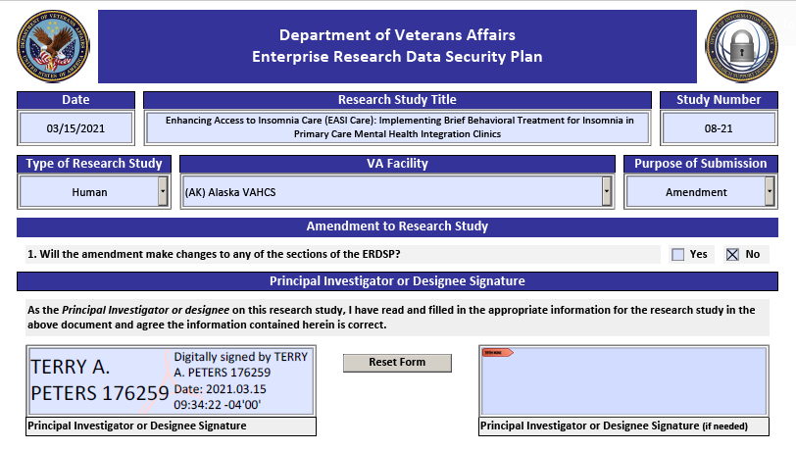
Research Study Amendments Making Minor Changes
If the research study amendment is only making minor changes to the research study, the PI completes (1) ERDSP heading information, (2) the PI answers NO on question 1, (3) the PI signs the ERDSP and submits the ERDSP with the protocol submission
Will the amendment make changes to any of the sections of the ERDSP?
44

Slide 45
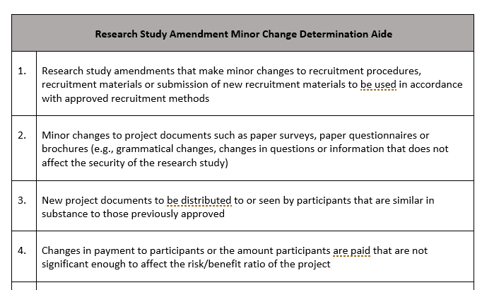
Research Study Amendment Minor Change Determination Aide
.

Slide 46
Training Scenario #1
SCENARIO: A VA PI plans to submit an amendment to a VA research study. The amendment will change the number of subjects that will be participating in the study from 400 to 750. Is the PI required to complete an ERDSP.
An ERDSP is required to be completed for all research study amendments. If the research study amendment is only making minor changes to the study (see ERDSP Guide Appendix C – Research Study Amendment ERDSP Determination Aide. the PI will take the following steps.
(1) Complete the ERDSP heading information
(2) Complete question 1 of the ERDSP
(3) Sign the ERDSP
(4) Submit the signed ERDSP with the protocol submission
46

Slide 47
Demo & Walk Through Accessing the ERDSP Toolset in VAIRRS/SharePoint

Slide 48
Demo & Walk Through of ERDSP Toolset

Slide 49
Submitting ERDSP Toolset/User Guide Feedback
ISSOs participating in the ERDSP pilot/soft release are encouraged to provide feedback/comments at the conclusion of the pilot and soft launch by using the following Feedback Submission Form
ERDSP Feedback Form Link available at https://vaww.portal2.va.gov/sites/infosecurity/fieldsecurity/rs/Lists/ERDSP%20Template%20Pilot%20Program%20Review/AllItems.aspx
03
04
05
06
For detailed screen shots access ERA User Guide)
49

Slide 50
Summary
01
Importance of the Use of the ERDSP Toolset
06
Review and Use of the ERDSP Toolset
02
Discuss the ERDSP Toolset Roles and Responsibilities
07
Review of Training Scenarios
03
Overview of the ERDSP within the IRB/R&D Study/Protocol Review Process
08
Demo & Walk Through of ERDSP Toolset & Accessing the ERDSP Toolset in VAIRRS/SharePoint
04
Review of Phased Implementation Schedule
09
Submitting ERDSP Toolset Feedback
05
Determining When a Study/Protocol Requires ISSO Review
50

Slide 51
References
RSD ERDSP Resource Portal (ERDSP Template, Guide and FAQs)
VAIRRS Portal
VAIRRS Trainer Energizer
ORD Research Information & Cybersecurity Toolkit
Research Support Division (RSD) Cybersecurity Policy Support Team OISISPSSSSRSDInformationSecuritySupport@va.gov

Slide 52
Availability of Recording
A recording of this session and the associated handouts will be available on ORPP&E’s Education and Training website approximately one-week post-webinar
An archive of this and other webinars can be found here: https://www.research.va.gov/programs/orppe/education/webinars/archives.cfm

Slide 53
QUESTIONS?

